Slide 1

Machine Learning with Hugging Face
Host: Ahad Jawaid

Slide 2
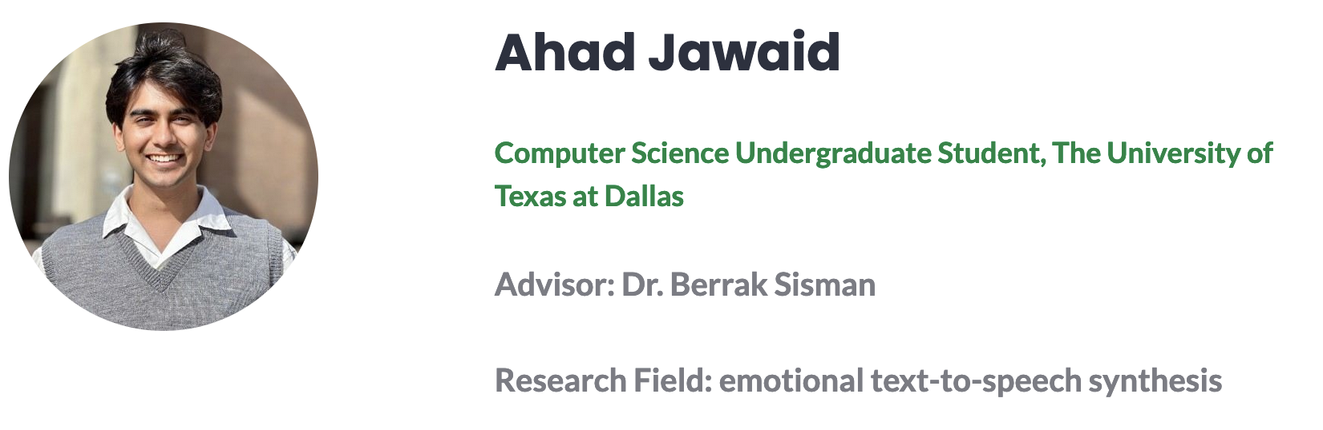


Who am I?

Slide 3
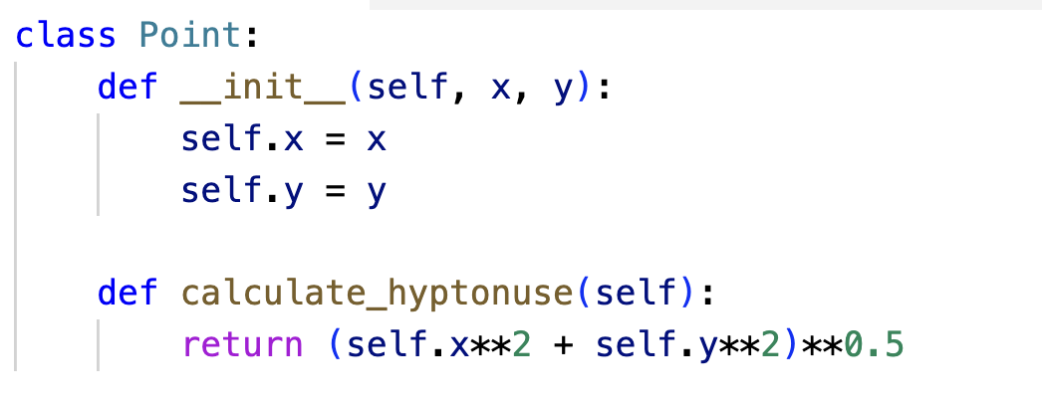
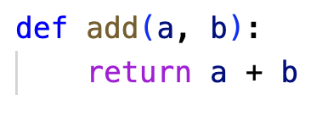
What I expect from you

Slide 4


Prerequisites
or

Slide 5
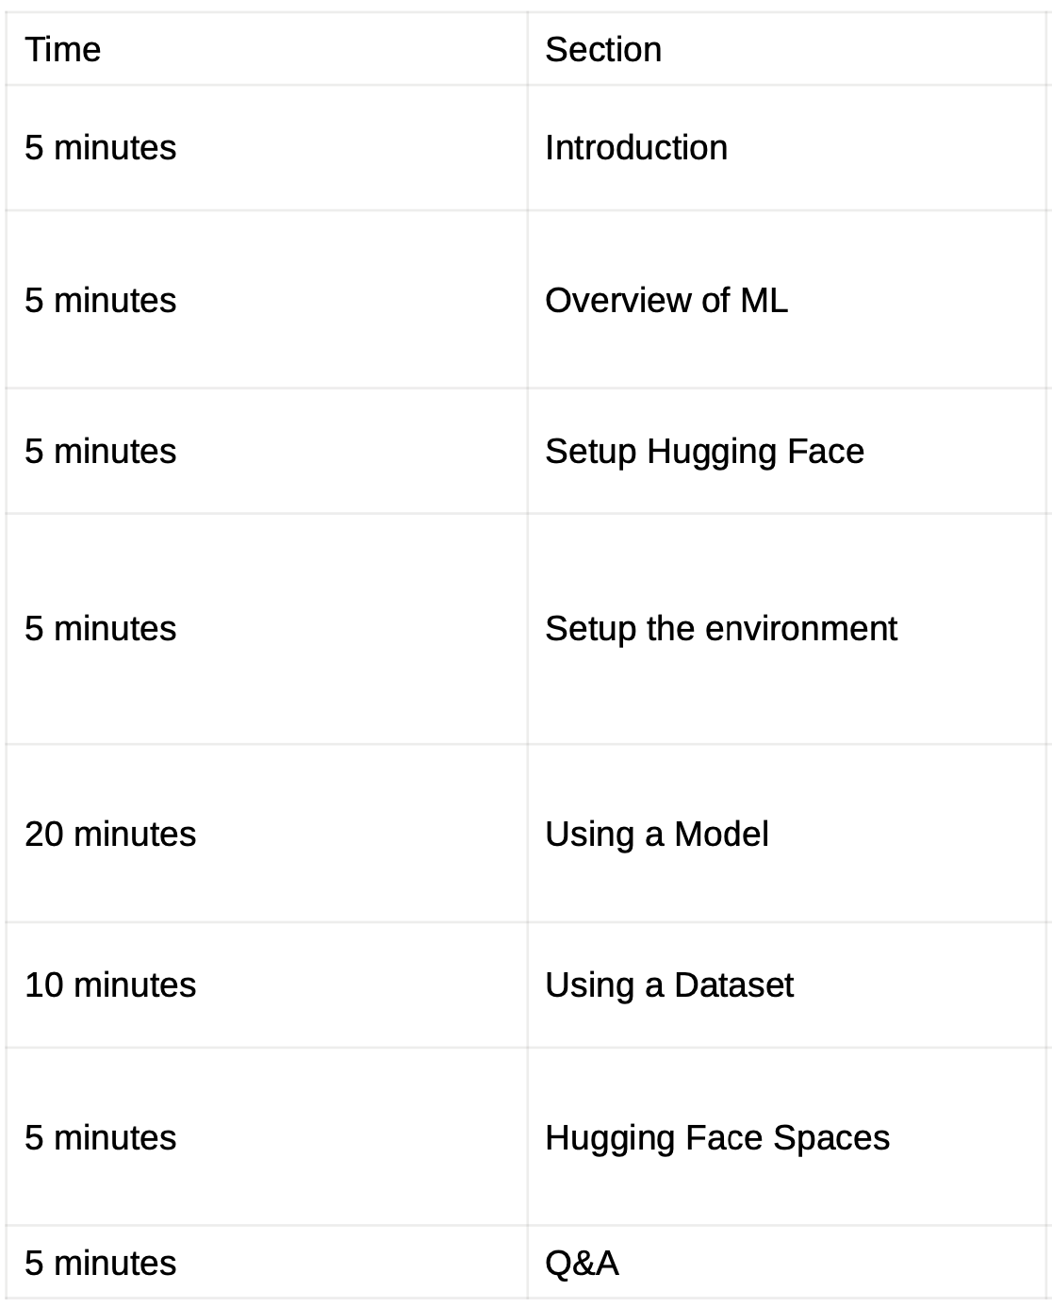
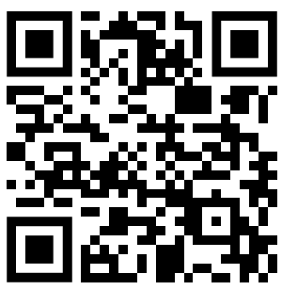
Overview
GitHub Link
github.com/ahadjawaid/hackutd-hf-workshop

Slide 6

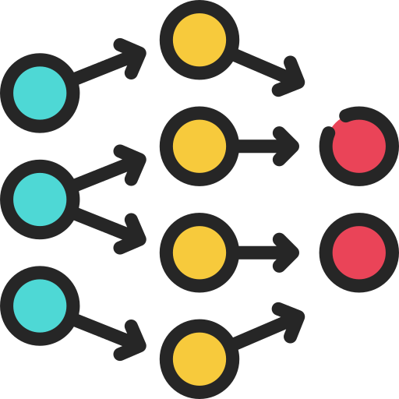
What is Machine Learning?

Slide 7
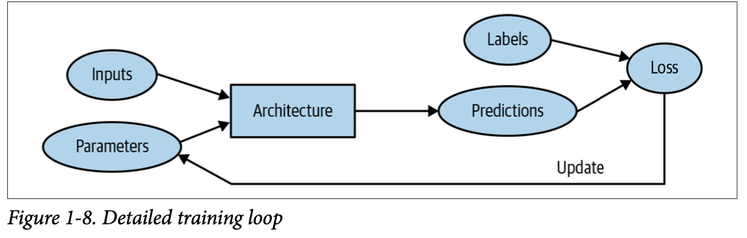
How it works

Slide 8

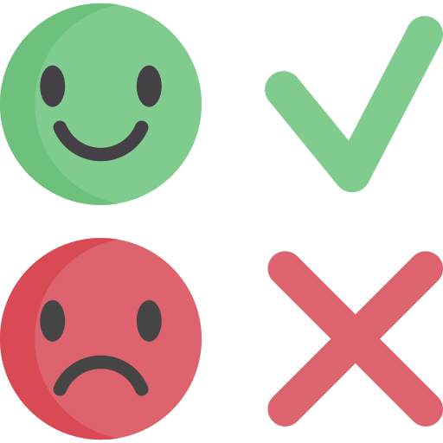
What are datasets?
Inputs
Desired outputs

Slide 9


What is a pretrained model?
Untrained model
Pretrained model

Slide 10

What does deploying mean?

Slide 11
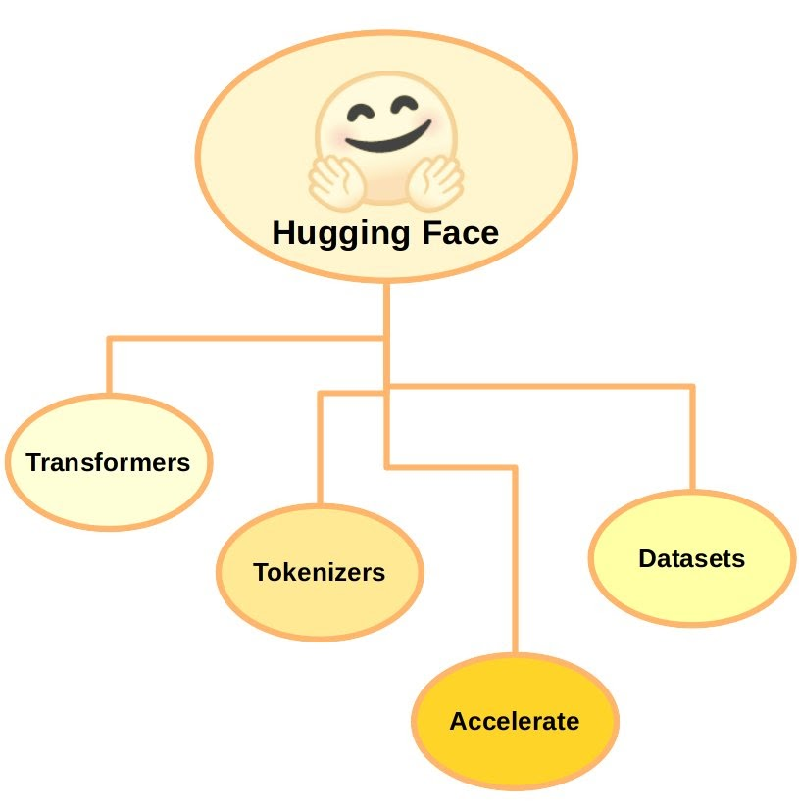
What is Hugging Face

Slide 12
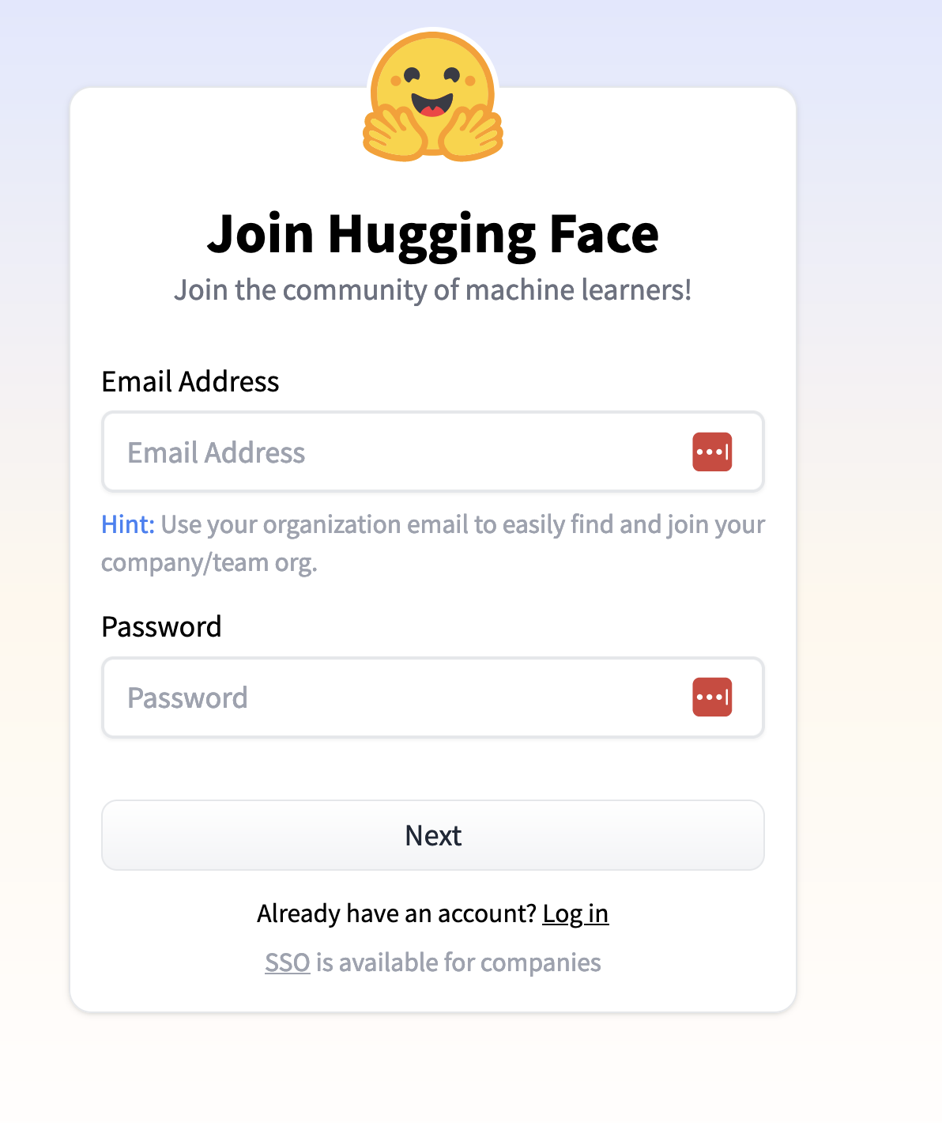
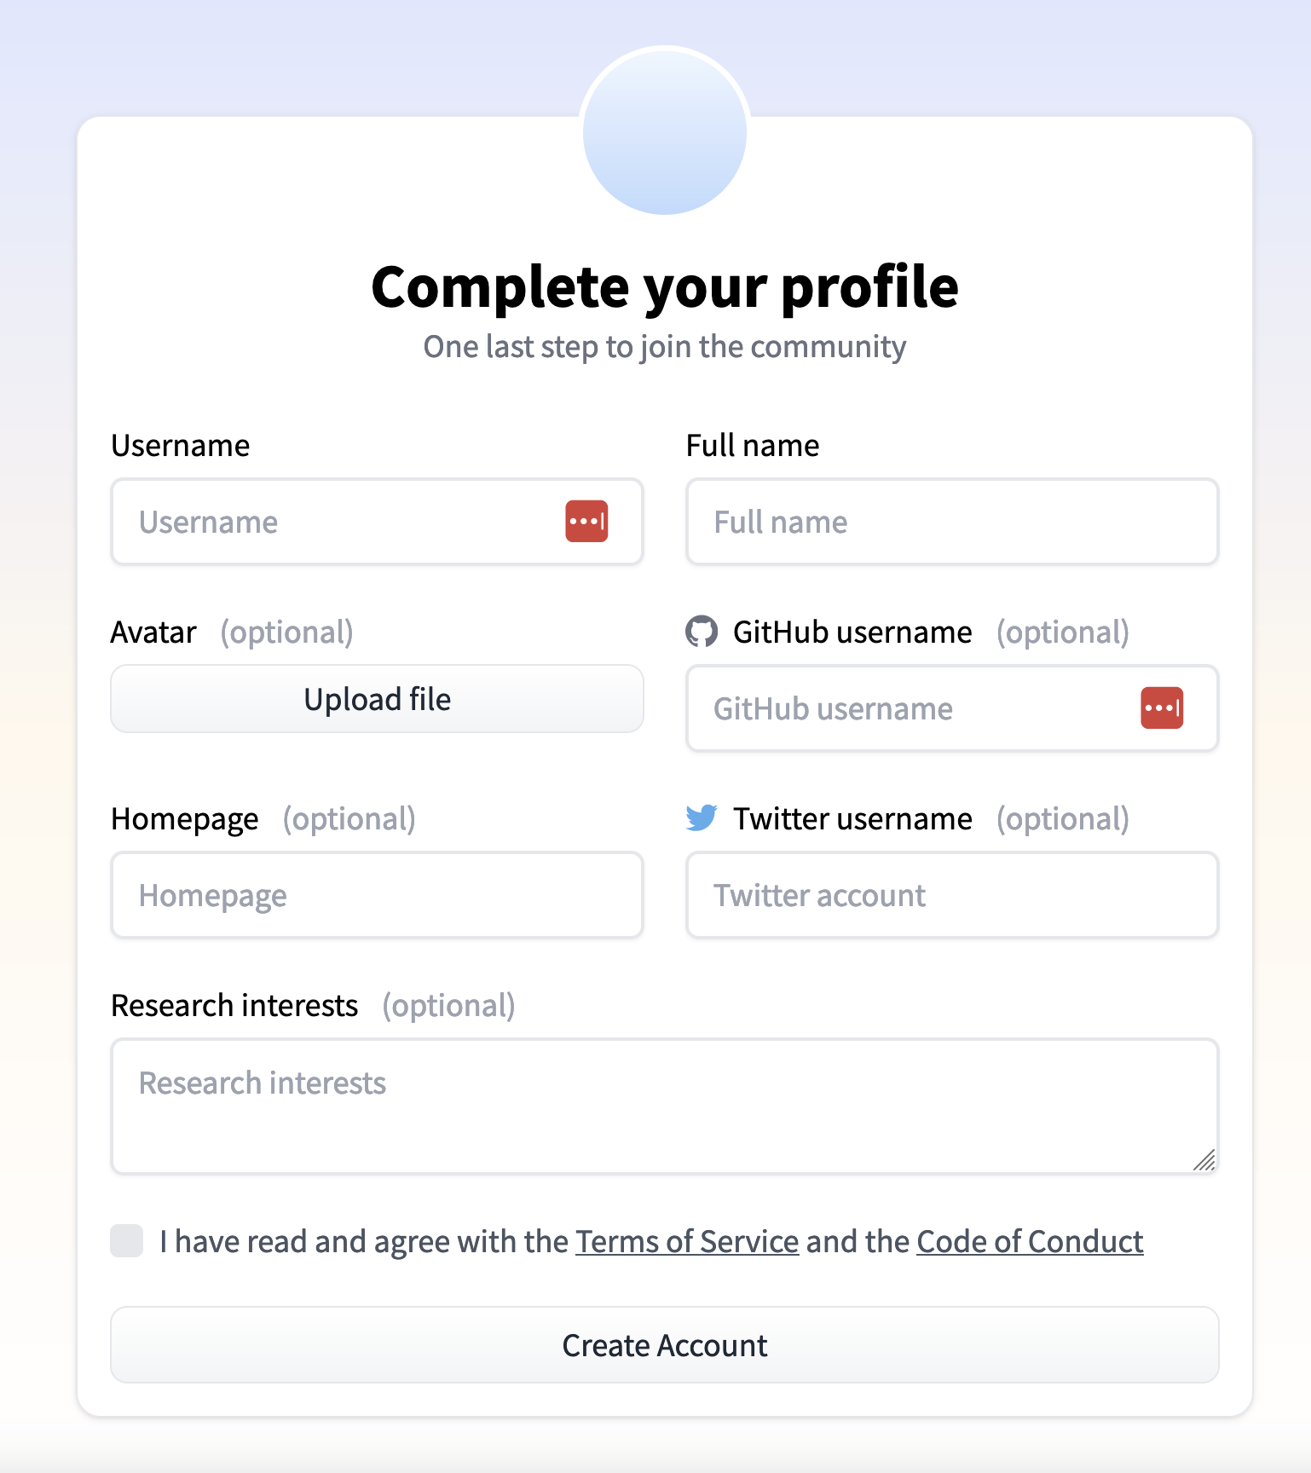
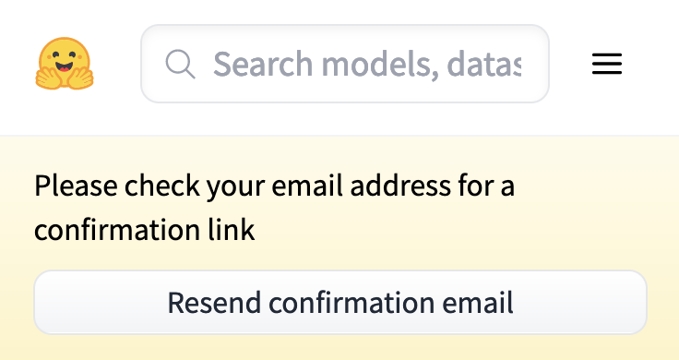
Creating a Hugging Face (HF) account

Slide 13
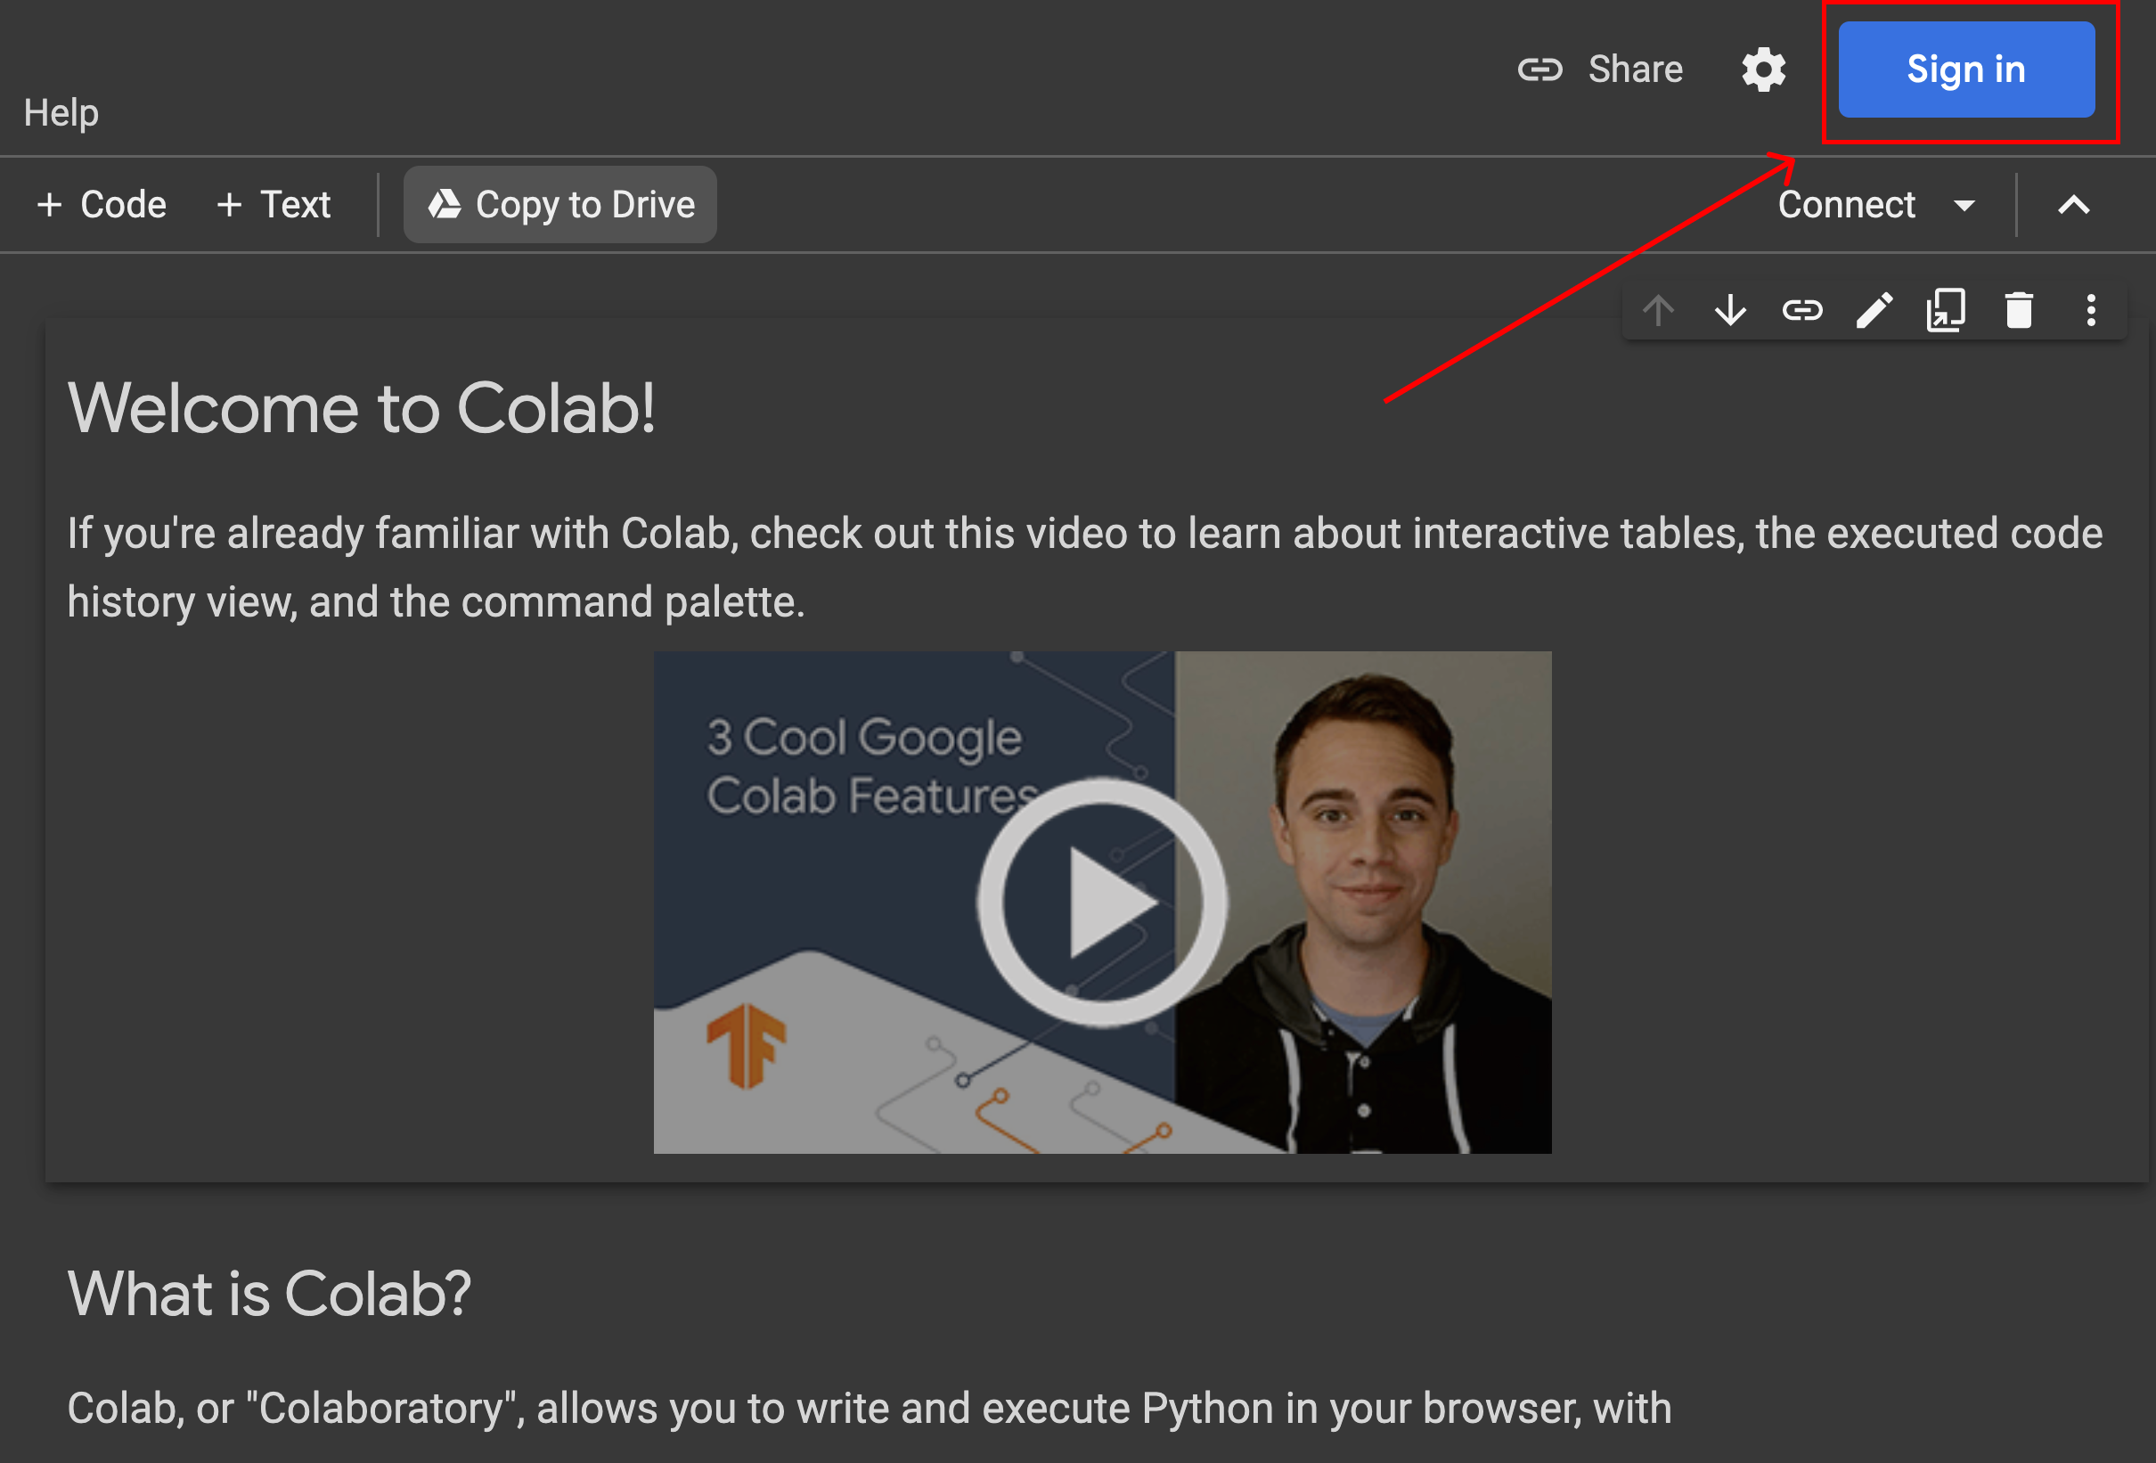
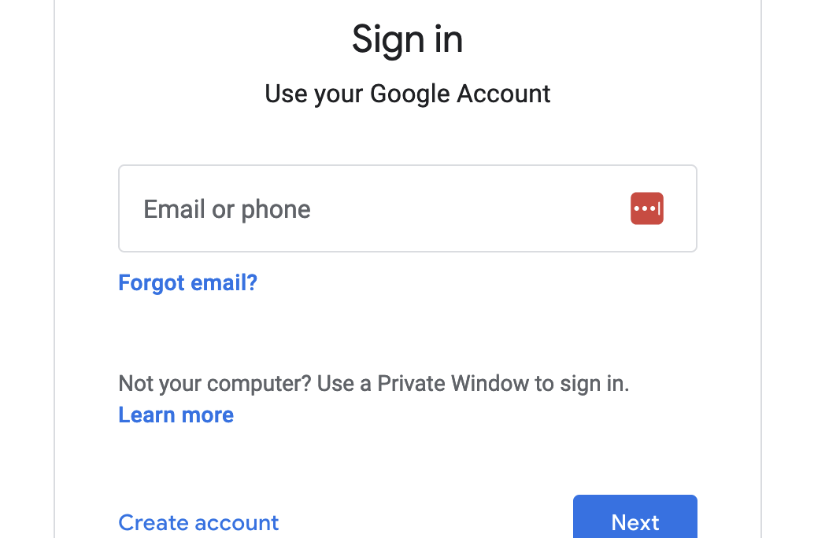
Using Google Colab

Slide 14
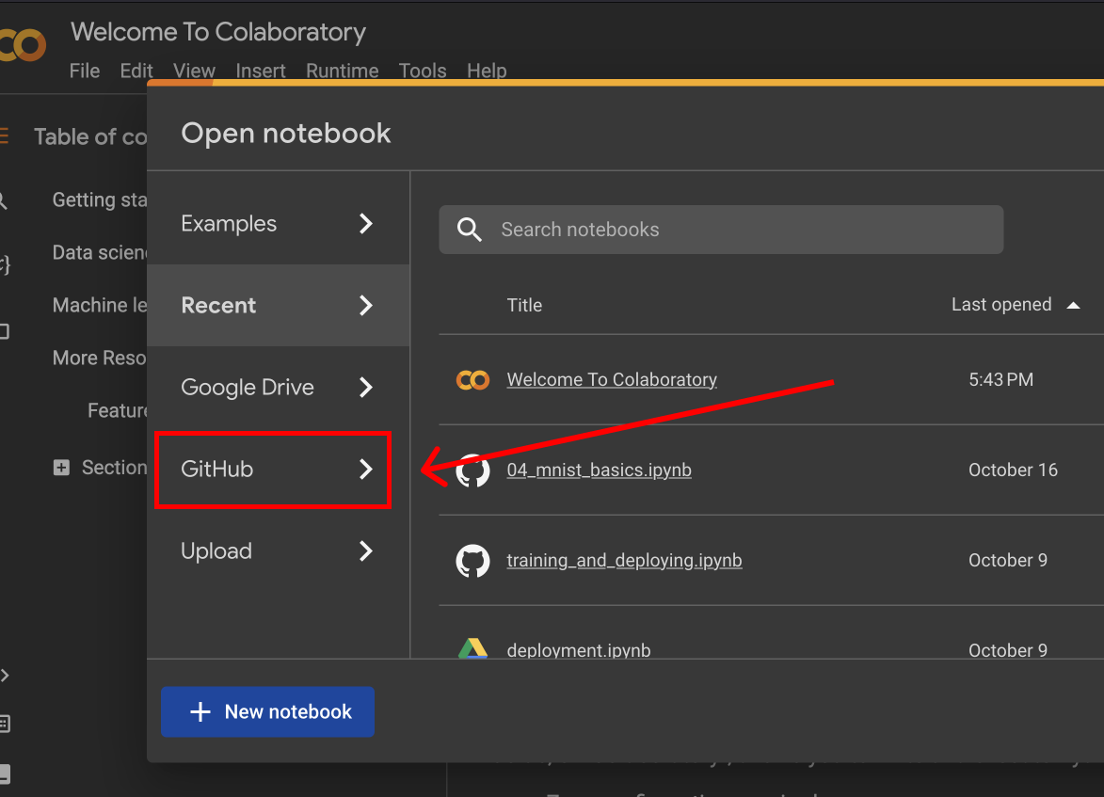
Using a notebook

Slide 15
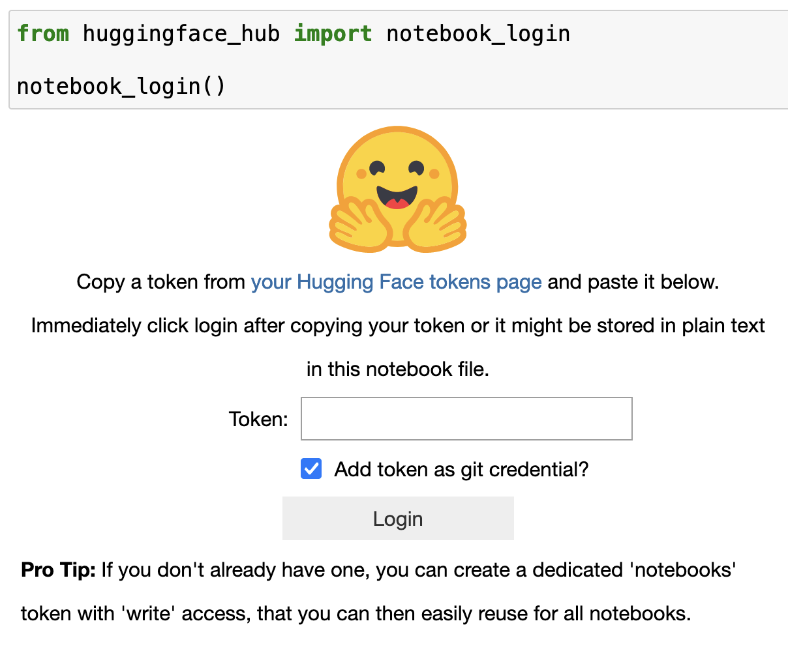
Accessing hugging face

Slide 16
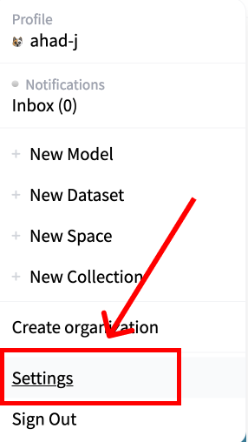
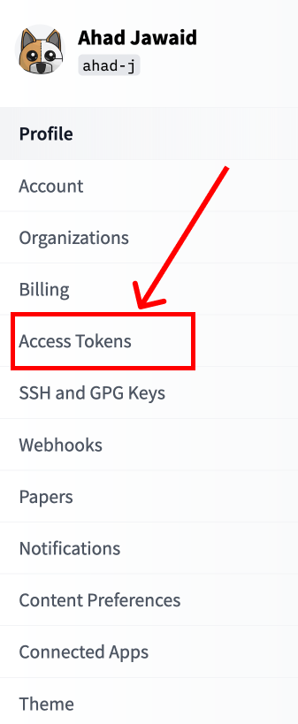
Getting hugging face token

Slide 17
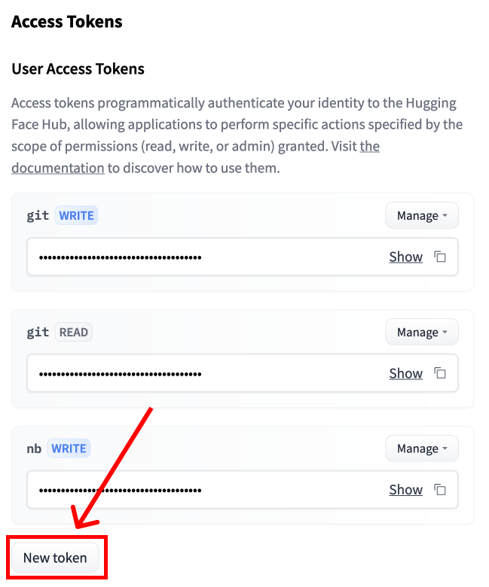
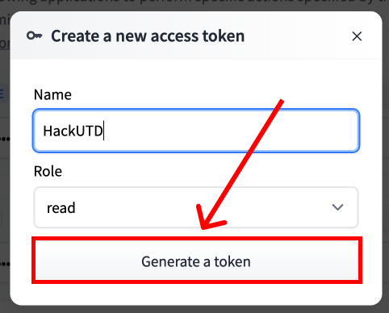
Getting hugging face token

Slide 18
Accessing hugging face

Slide 19
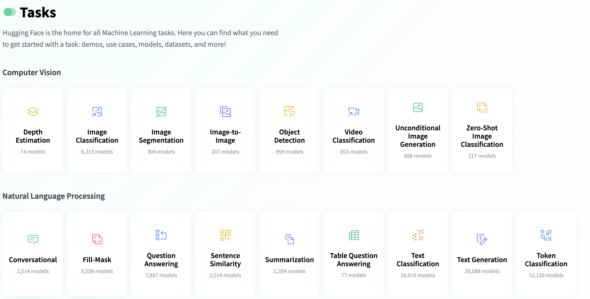
Browsing Hugging Face Tasks
https://huggingface.co/tasks

Slide 20
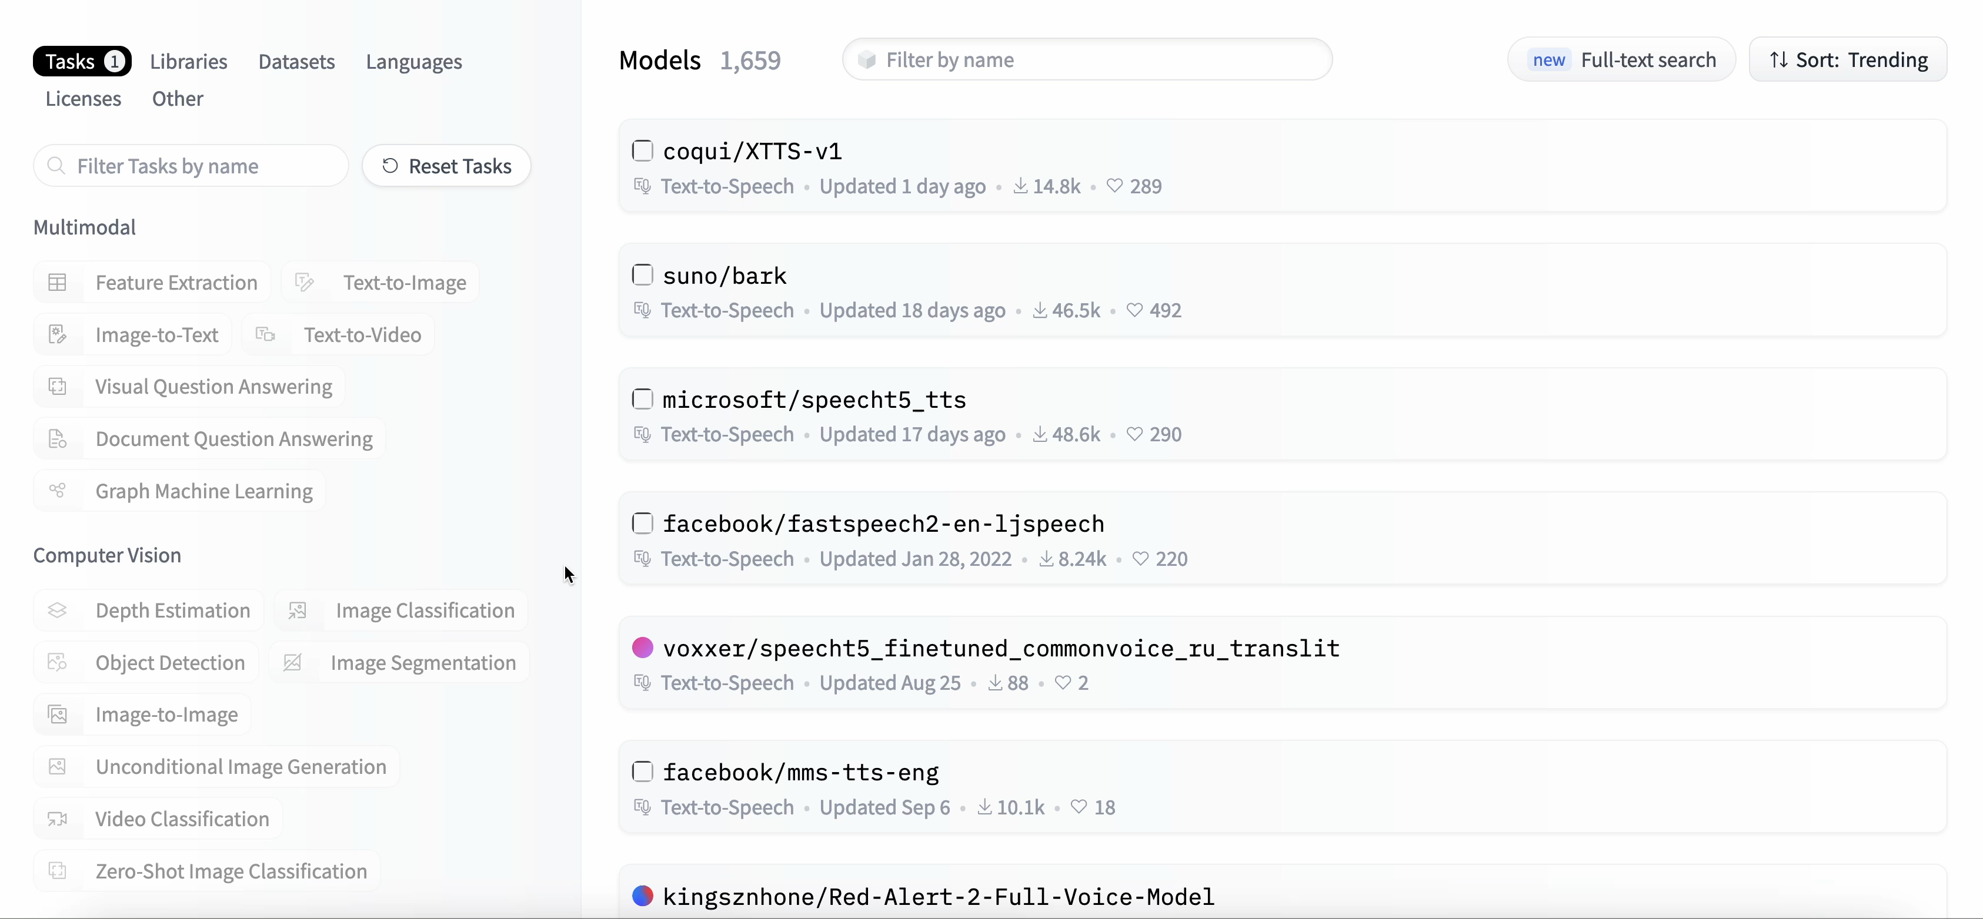
Importing Model

Slide 21
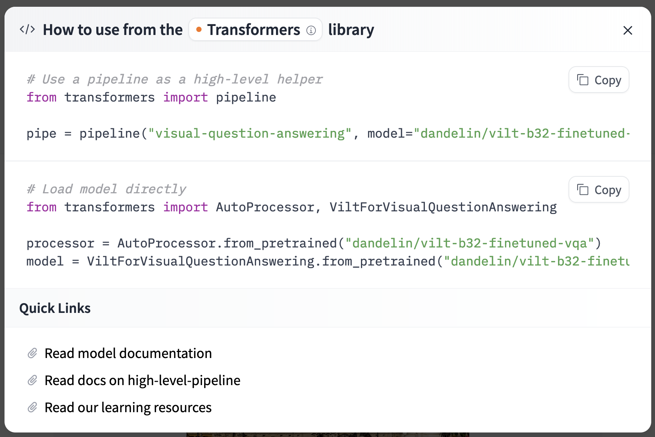
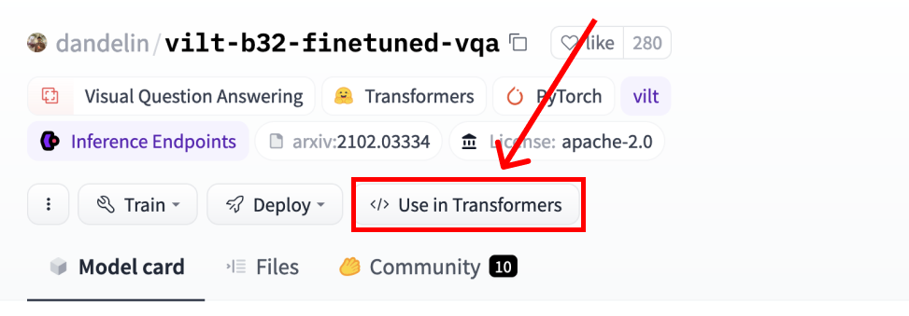
Using the model

Slide 22
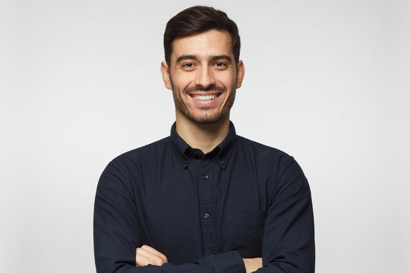
Input

Slide 23
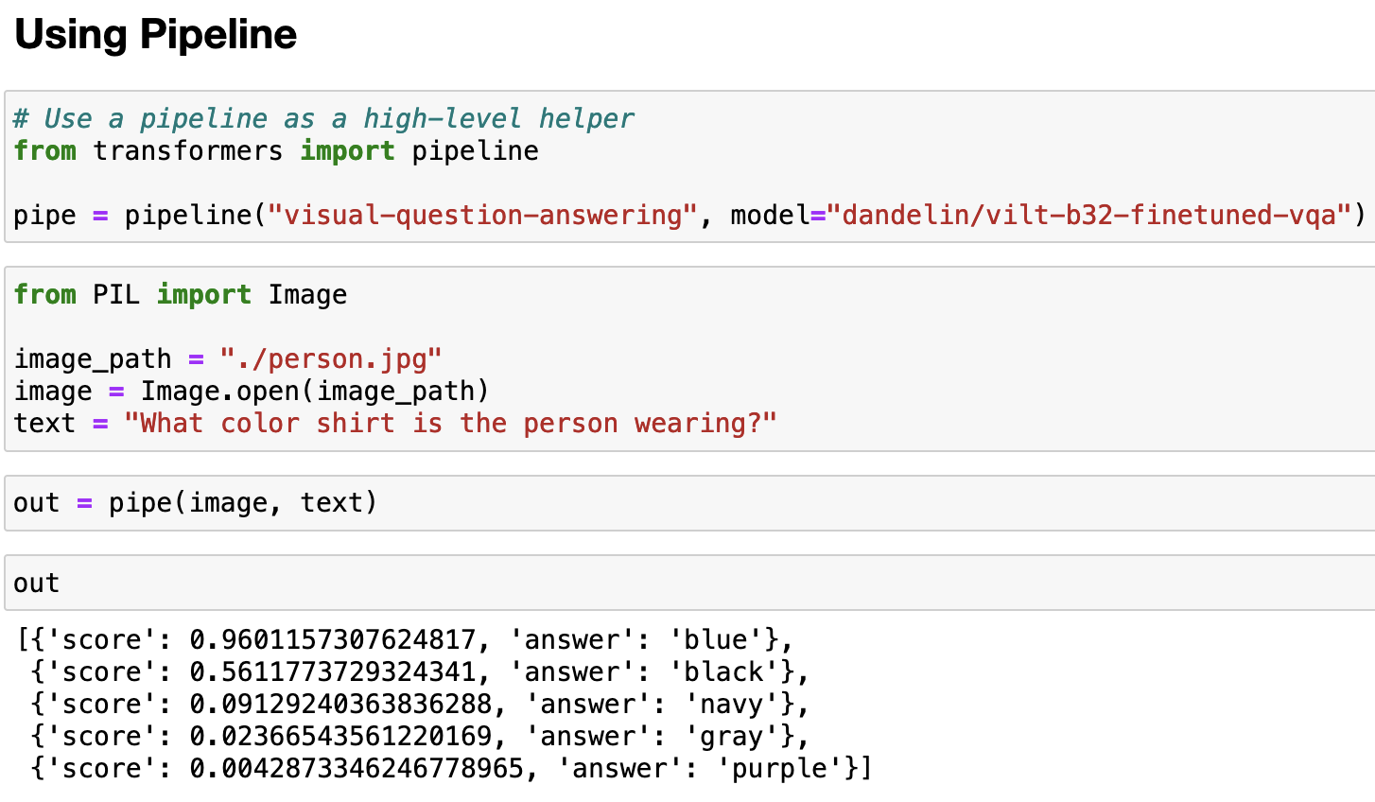

Slide 24
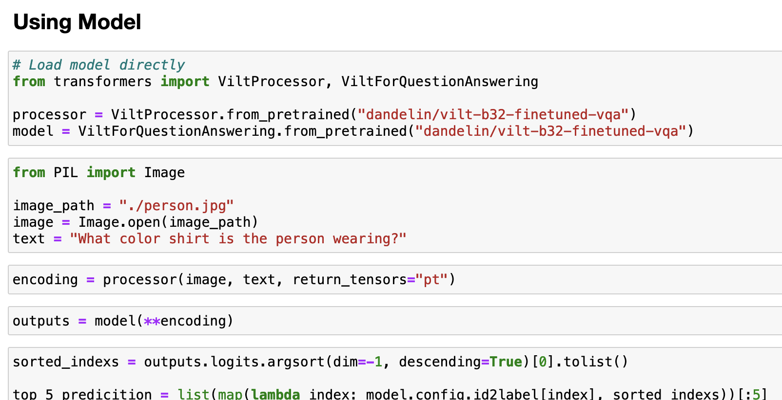

Slide 26
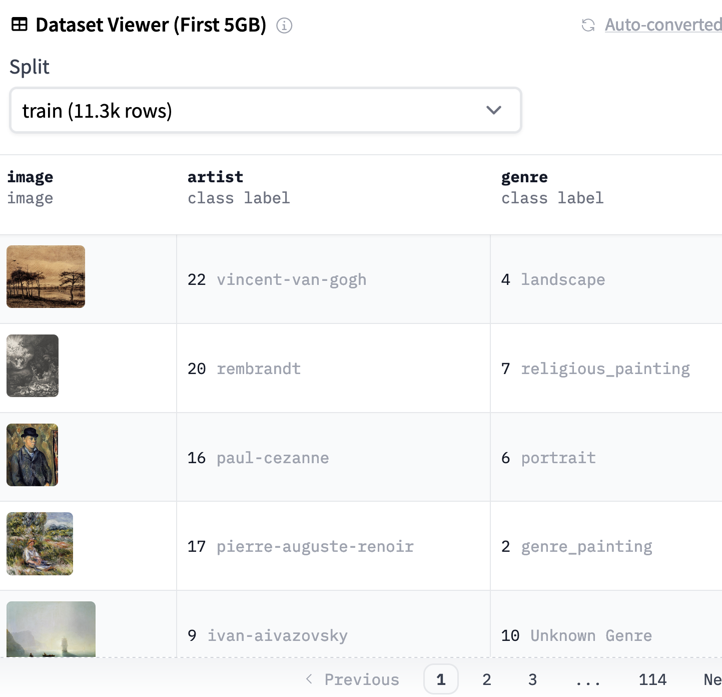
How datasets look like

Slide 27
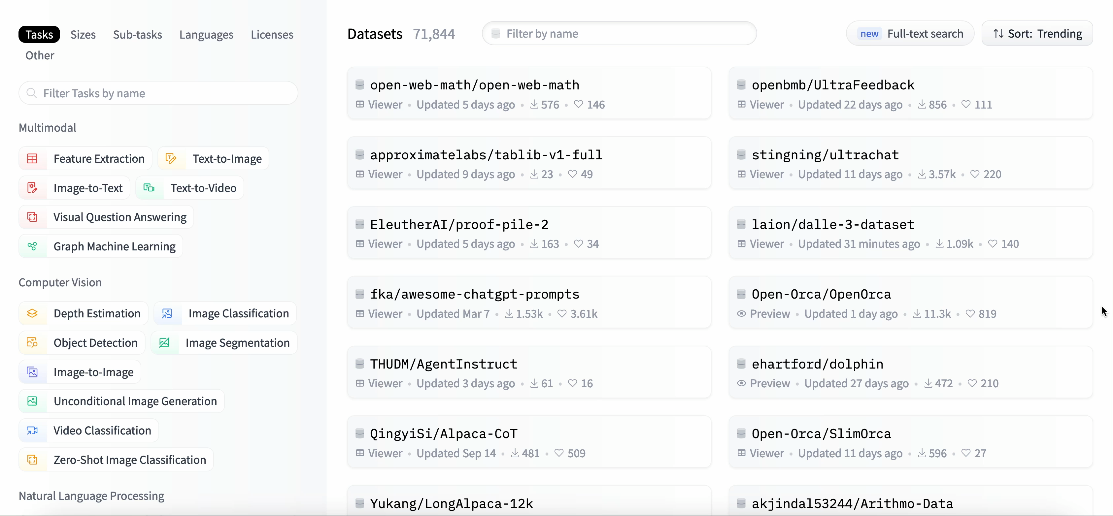
Browsing Hugging Face Datasets

Slide 28
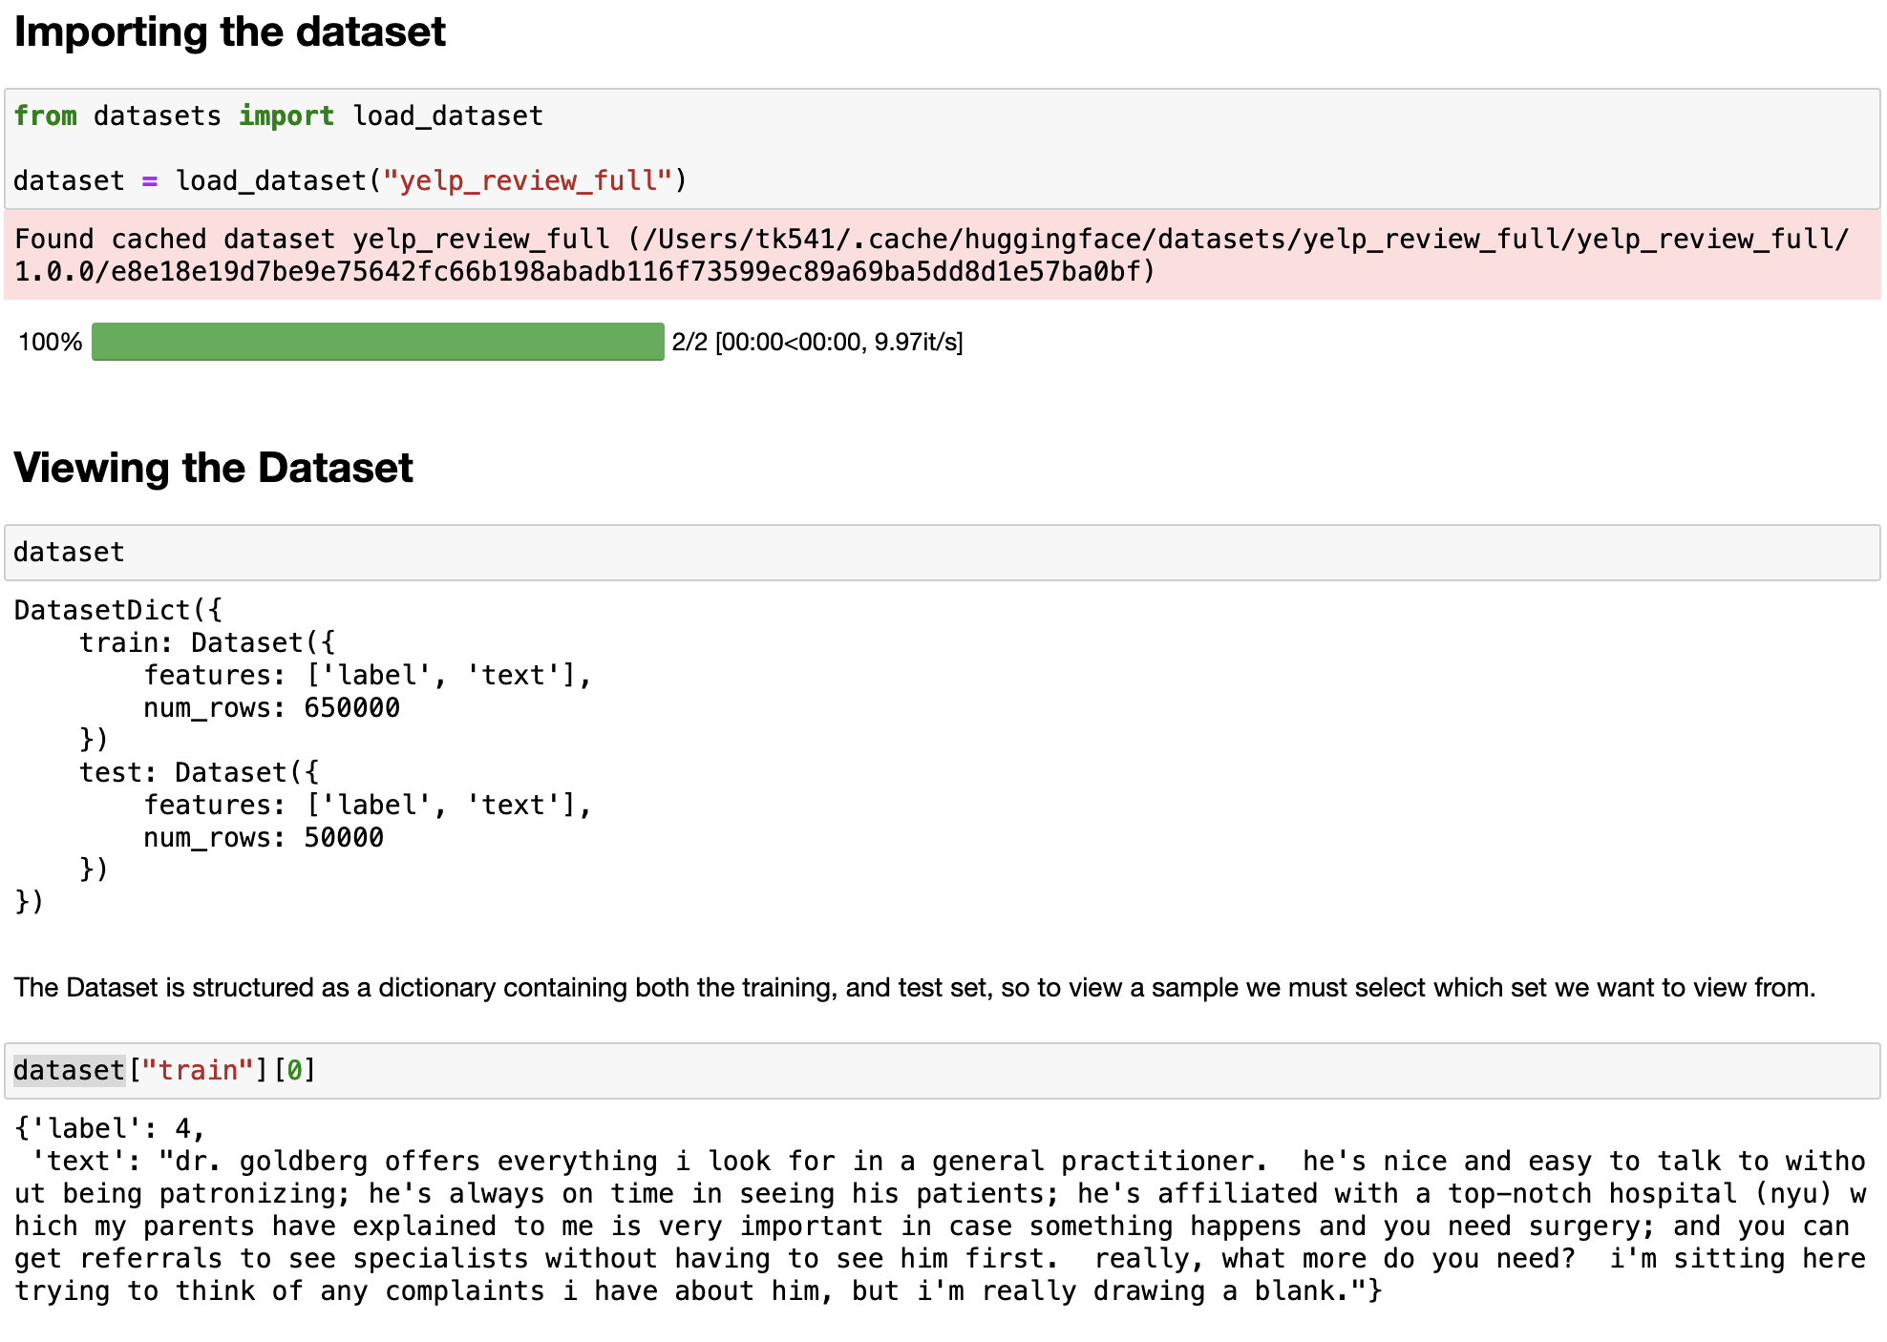

Slide 29
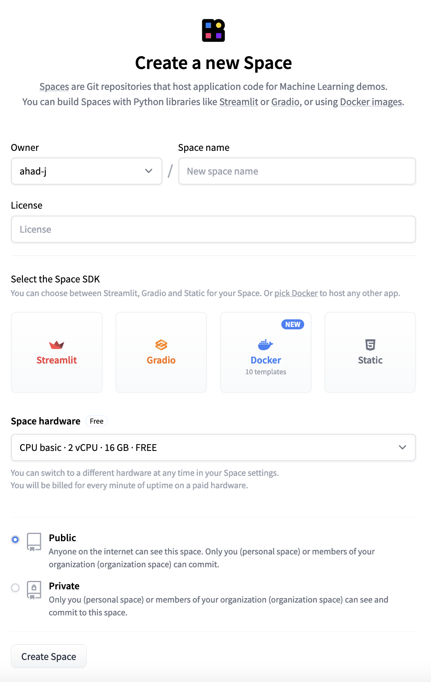
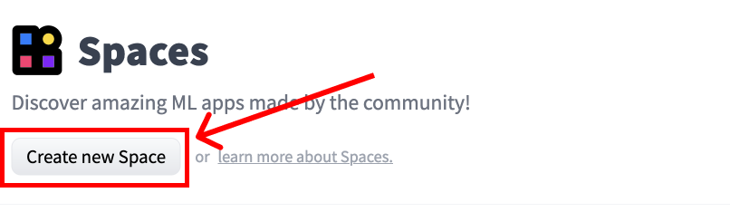
What is hugging face spaces

Slide 30
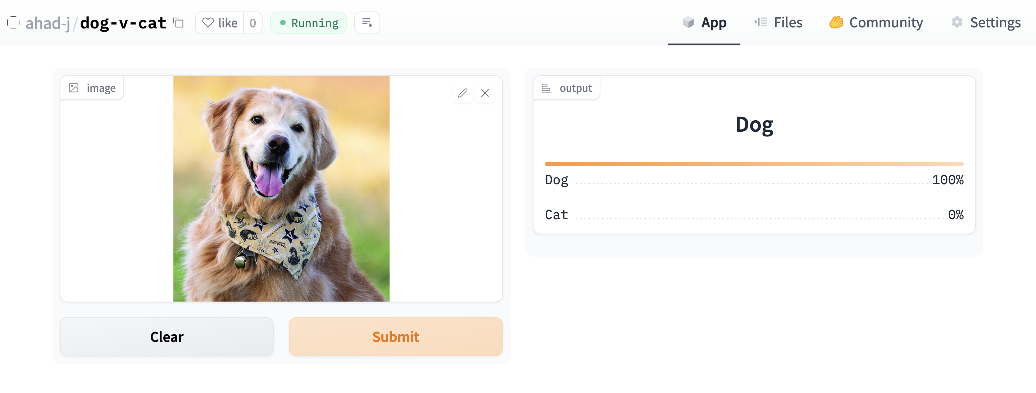
Deploying on Spaces

Slide 31
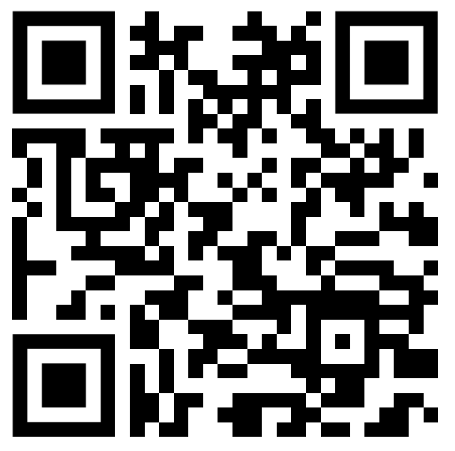
Q&A
Feedback Form
https://forms.gle/9gmj7wYjm1Rc5jhW6

